Slide 1
DevOps 101 for Data People 2pm BST (UTC + 1)
DevOps has fundamentally changed the way we manage IT. Those practicing DevOps well aren't just outpacing their competitors, they are annihilating them.
DevOps brings a whole host of new practices, tools and buzzwords. It has made some roles and tasks redundant, while new opportunities have been created.
Whether we have days or decades of career experience behind us, we all need to learn to thrive in this new reality.
In this session we'll cut through the hype and look at the key concepts and findings from the Puppet State of DevOps Reports, The DevOps Handbook and Microsoft's work in this space.
We will finish with an overview of a SQL Server Data Tools (SSDT) project in a public GitHub repo with automated GitHub Actions automatically build and release updates.

Slide 2
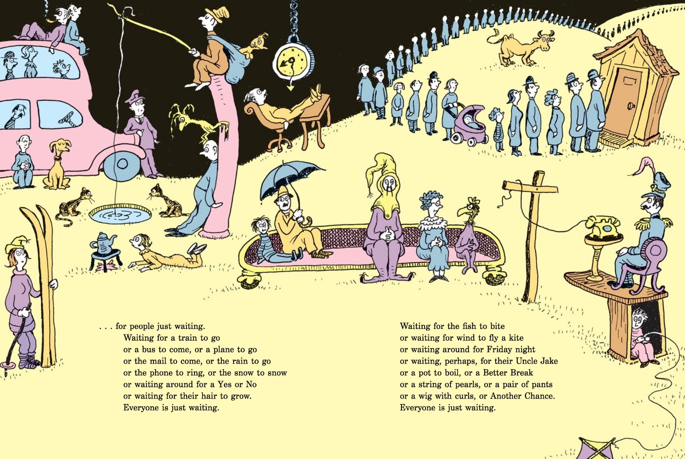
Story time
Oh, The Places You’ll Go! Dr. Suess
The Waiting Place
Notes:
For many of us, IT work is painfully inefficient. We are always waiting for some ticket, some approval, someone else to complete some task. It takes us forever to ship our work.

Slide 3
Netflix model
Diversity
Collaboration
User Feedback
Transformational Leadership
Silos
Generative Culture
Matrix management structure
Feedback Loops
Telemetry
Empowered Teams
Developers On-Call
Work In Progress (WIP) Limits
Security
2-pizza teams
Safety Culture
Shift left
Lightweight Change Approval
Self Service
Experimentation
Cycle Time
Agile
BizDevOps DevSecOps DataOps NoOps GitOps Etc
TDD
NoSQL
Infrastructure as code
Reverse Conway Manoeuvre
Source control
Automation
Lean
Culture
Pair programming
KanBan
Hand-offs
The Cloud
Continuous Integration Continuous Delivery Continuous Deployment
Pull requests
Code Review
Bottlenecks
Feature Toggles
Toyota Production System
A/B Testing
Open source
Trunk-based development
Containers
Single-Piece Flow
Minimal Viable Product
Small Batch Sizes
Test Data Management
Tools
Virtualisation
Deployment pipelines
Chaos Monkey
SRE
Chaos Engineering
Blue/Green deploys
Zero Downtime Deploys
Reducing Waste
DRE
Cluster immune system
Canary Releases
Testing in Production
Constraints
Value Stream Mapping
Loosely Coupled Architecture Microservices
Notes:
DevOps tries to fix that. But it’s not just a single thing. There are so many ideas. They are all interesting, but to explore them all is overwhealming.

Slide 4

“Start with Why” Simon Sinek
Notes:
This is a 101 session, in Simon Sinek’s words, I’m going to start with why. What’s the point?

Slide 5
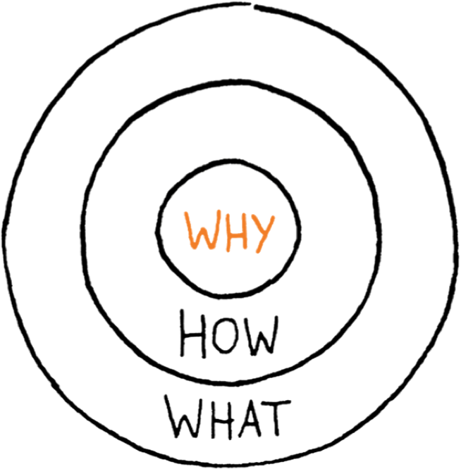
“Start with Why” Simon Sinek

Slide 6
Why?
Why should everyone care about DevOps?

Slide 7
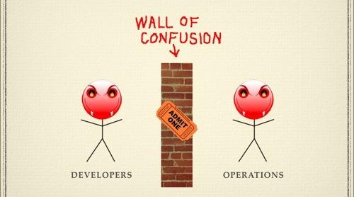
The Core Chronic Conflict
Responding to urgent business needs
Innovation and experimentation
Rapid time to market
Stable, Secure, Reliable IT
Maintaining existing systems
Compliance and Data Protection
By Andrew Clay Shafer
Notes:
Returning now to the core chronic conflict, if we imagine a world where we are making smaller, more frequent changes, we can turn that core vicious circle into a virtuous one

Slide 8
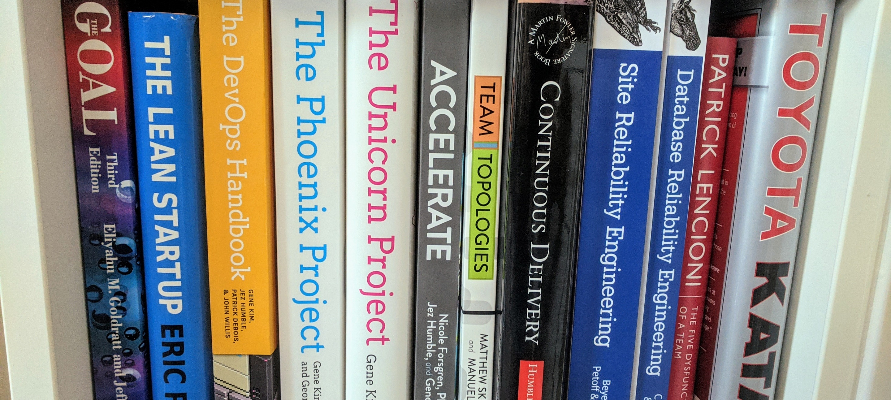
Notes:
Many books were written in that space

Slide 9
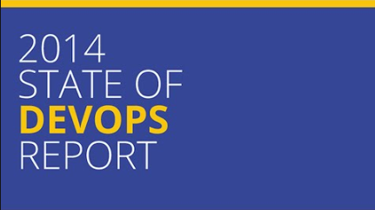
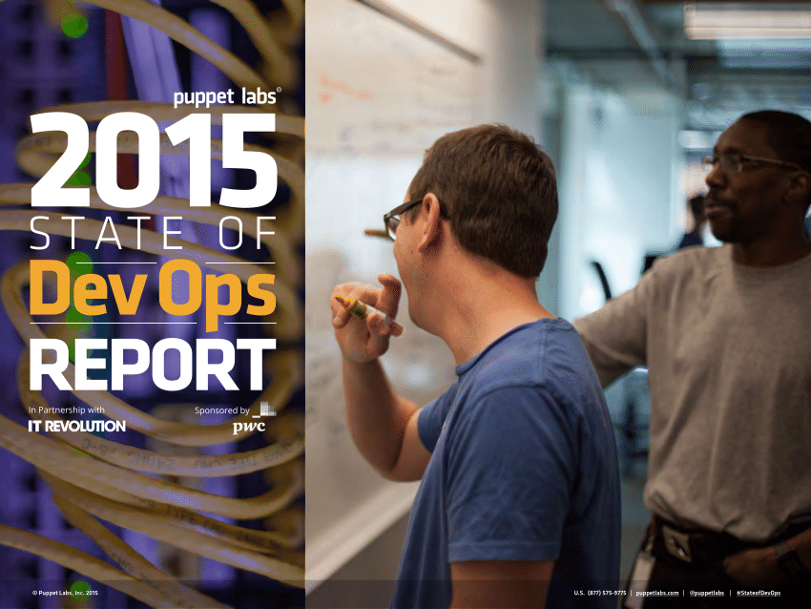
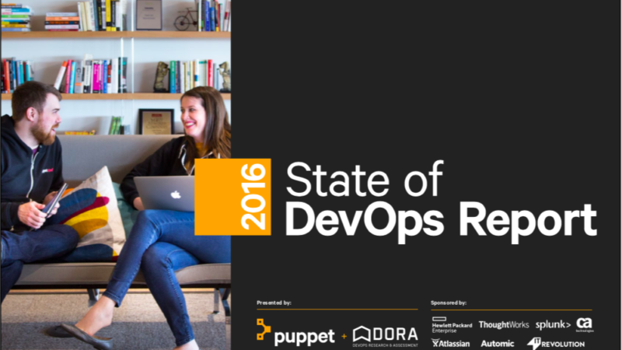
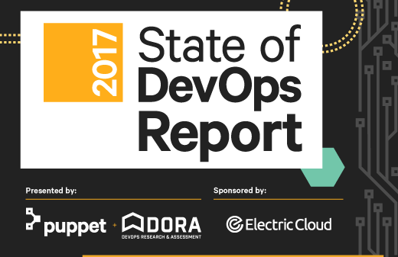
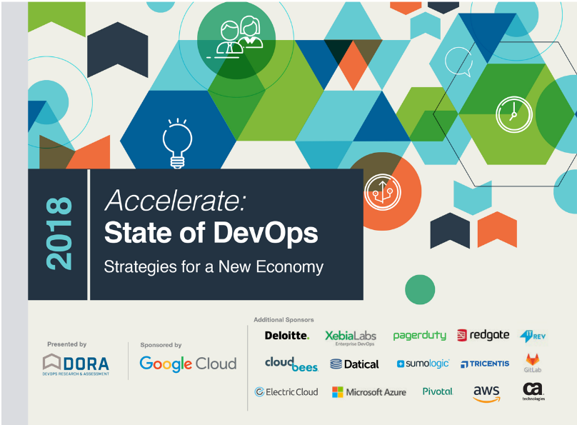

Notes:
And a bunch of polls/research, most notably the state of devops reports

Slide 10

Notes:
I believe the best place to start our journey, especially for data folks, is with Accelerate. Nicole Forsgren articulately and persuasively demonstrates that DevOps isn’t just hype, it is predictive of positive business outcomes

Slide 11
Deployment Frequency
Lead Time
Mean Time to Restore (MTTR)
Change Failure Percentage
(Hint: This forces you to think about small batch sizes.)
Notes:
She groups respondents as low, medium and high performers with respect to these metrics. Why these metrics?

Slide 12
“Analysis over several years shows that high-performing organizations were consistently twice as likely to exceed [the profitability, market share and productivity of] low performers.”
Accelerate, Ch2: Measuring performance
Notes:
These metrics are predictive of positive business outomes

Slide 13
Deployment Frequency
Lead Time
Mean Time to Restore (MTTR)
Change Failure Percentage
(Hint: This forces you to think about small batch sizes.)
Notes:
One key observation, is that these necessitate small, frequent releases.

Slide 14
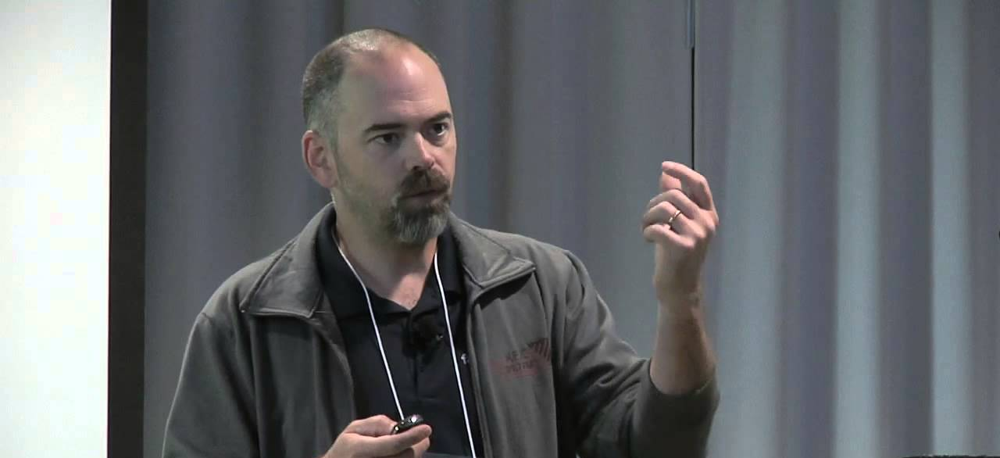
“If we want more changes, we need more deployments”
Chuck Rossi, Facebook
Notes:
As chuck rossi put it, there once any release grew above a certain size, it would predictably fail and cause significant harm. Hence, if your biz wants to move faster, you need more releases, not bigger releases.

Slide 15
Deployment Frequency
Lead Time
Mean Time to Restore (MTTR)
Change Failure Percentage
(Hint: This forces you to think about small batch sizes.)
Notes:
One key observation, is that these necessitate small, frequent releases.

Slide 16
The Core Chronic Conflict
Responding to urgent business needs
Innovation and experimentation
Rapid time to market
Stable, Secure, Reliable IT
Maintaining existing systems
Compliance and Data Protection
Slide by Andrew Clay Shafer
Notes:
Returning now to the core chronic conflict, if we imagine a world where we are making smaller, more frequent changes, we can turn that core vicious circle into a virtuous one

Slide 17
How?
This is a massive change. It seems impossible! How do you do it?
Notes:
Let’s start by observing the two biggest influences on DevOps – Lean and Safety Culture

Slide 18

“In any flow of work, there’s a direction of flow, but there is one and only one bottleneck. And any improvement not made at the bottleneck is an illusion.”
Eliyahu M. Goldratt, The Goal
Notes:
Understanding flow, value streams and bottlenecks/constraints in a little more detail

Slide 19
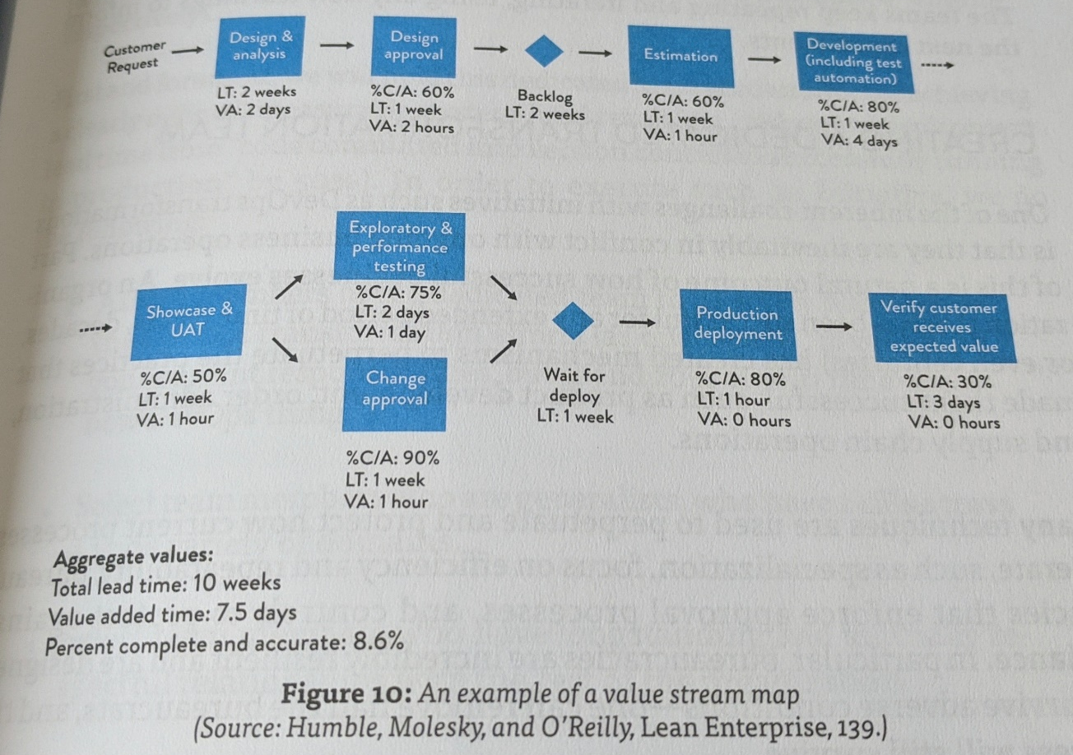
The Value Stream Map (VSM)
Notes:
VSM

Slide 20
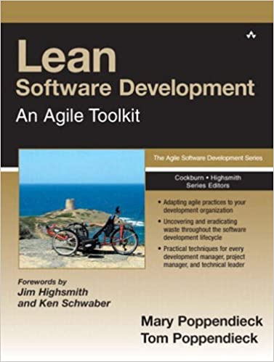

The 5 key principles of Lean
Value (prioritising the most important work)
Value Stream (removing constraints and global optimisation)
Flow (and feedback)
Pull (Kanban and WIP limits)
Kaizen (Andon chords and the pursuit of perfection)
Notes:
Brief overview of lean

Slide 21
The 7 deadly sins of lean software development
Inventory > Partially done work
Over production > Feature creep
Extra processing > Relearning
Transportation > Hand-offs
Waiting > Delays
Motion > Context switching
Defects > Defects
Notes:
Why is it that big deployments are so bad. Let’s explore this through the lense of Mary and Tom Poppendeicks 7 deadly sins.

Slide 22
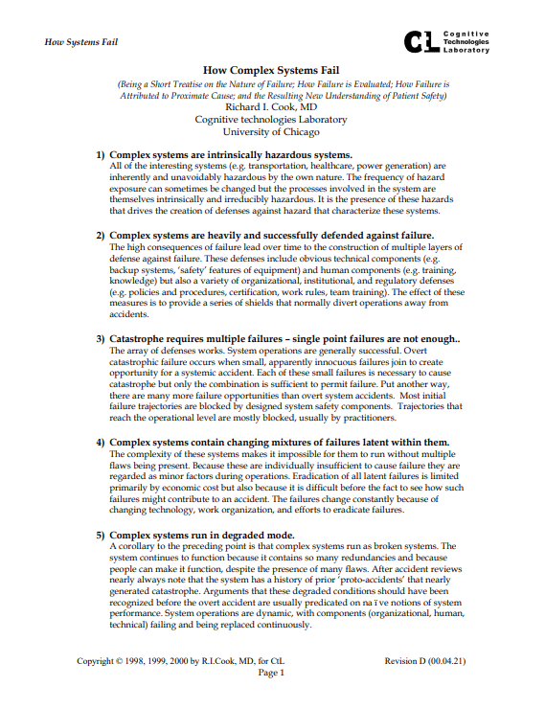

Safety Culture: How Complex Systems Fail
#16 out of 18:
“Safety is a characteristic of systems and not of their components”
Notes:
Brief overview of safety culture

Slide 23
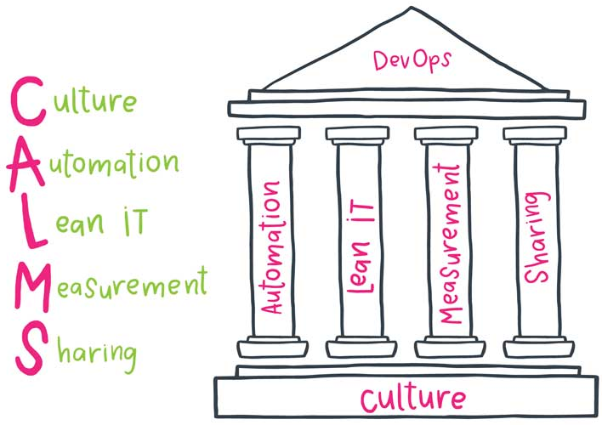

Calms
John Willis
Image by DevOps Group
Notes:
Calms, one of the early attempts to codify what devops was about

Slide 24
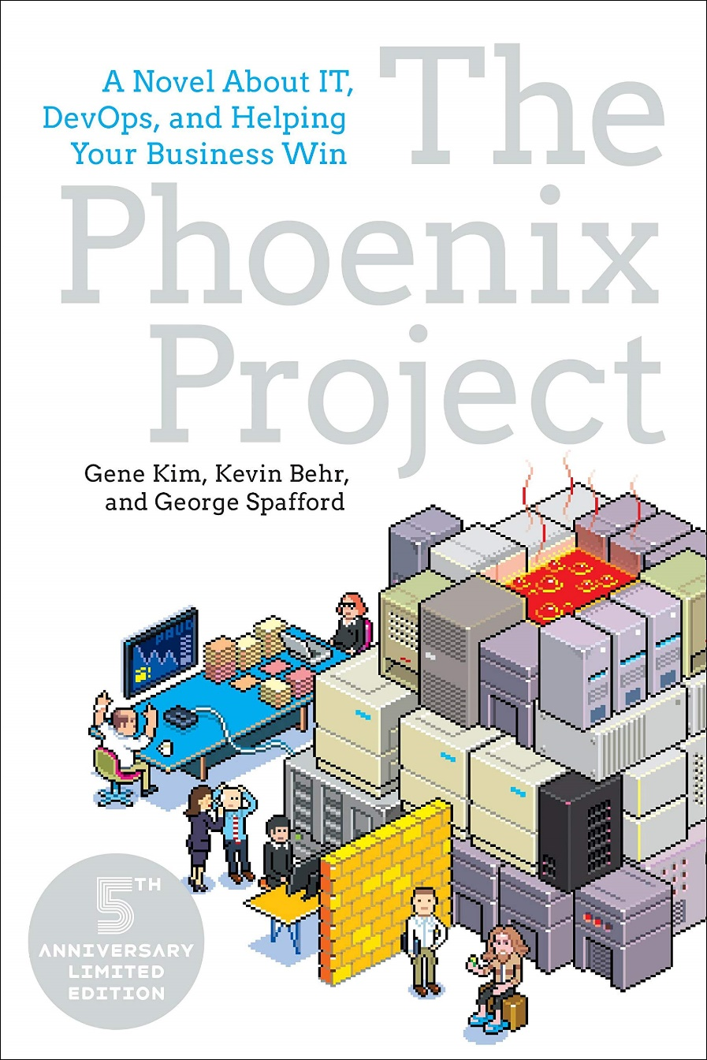

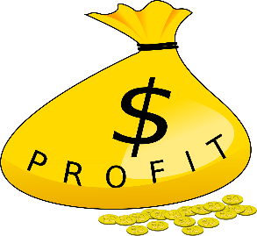
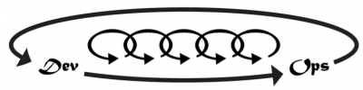
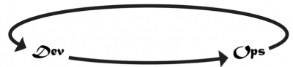
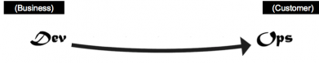
The Three Ways
(Aha! To Kerching!)
Flow
Feedback
Continuous experimentation and learning
Notes:
The three ways, describing the process as a transformation and the driving objectives

Slide 25
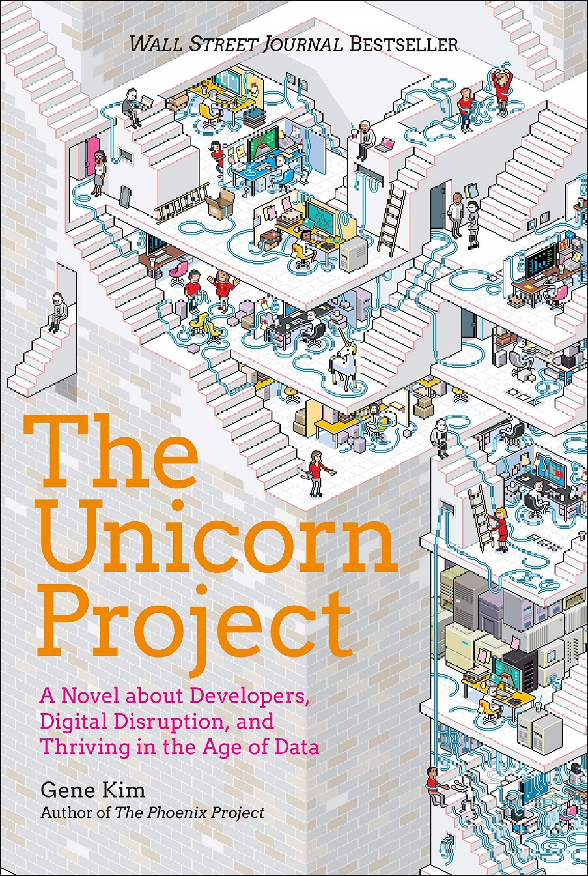
The Five Ideals
Locality and simplicity
Focus, Flow and Joy
Improvement of Daily Work
Psychological Safety
Customer Focus
Notes:
Another lense, The 5 ideals from the Unicorn Project. Can easily see how these ideals promote the best behaviours with respect to lean principles and the core chronic conflict.

Slide 26
What?
Enough theory. Show me some practical examples!

Slide 27
24 capabilities to drive improvement
Version control
Deployment automation
Continuous integration
Trunk-based development
Test automation
Test data management
Shift left on security
Continuous delivery
Loosely coupled architecture
Architect for empowered teams
Seek out customer feedback
Visualise work through stream
Work in small batches
Foster team experimentation
Lightweight change approvals
Monitor across app and infra
Check system health proactively
Implement WIP limits
Visualise work and quality
Generative culture
Support learning
Collaboration across teams
Make work meaningful
Transformational leadership
Notes:
These 24 capabilities drive the 4 key metrics, which drive biz outcomes

Slide 28

“What I find so amazing, is that as an organization goes from a code deployment lead times that are measured in months, maybe even in quarters, down to minutes, the constraint moves in some pretty predictable ways.”
Gene Kim, Beyond the Phoenix Project
Environment creation
Code deployment
Testing
Architecture
Ideas
Infrastructure as code
Continuous delivery
Shift-left and automate
Loosely coupled
Learning organisation
Notes:
Gene Kim offers a simpler version

Slide 29
Demo
github.com/Alex-Yates/DevOps101_Demo
Notes:
Demo: Git pull, f5 to generate a dev DB, make a change, commit to git, push, auto deploy to prod.

Slide 30
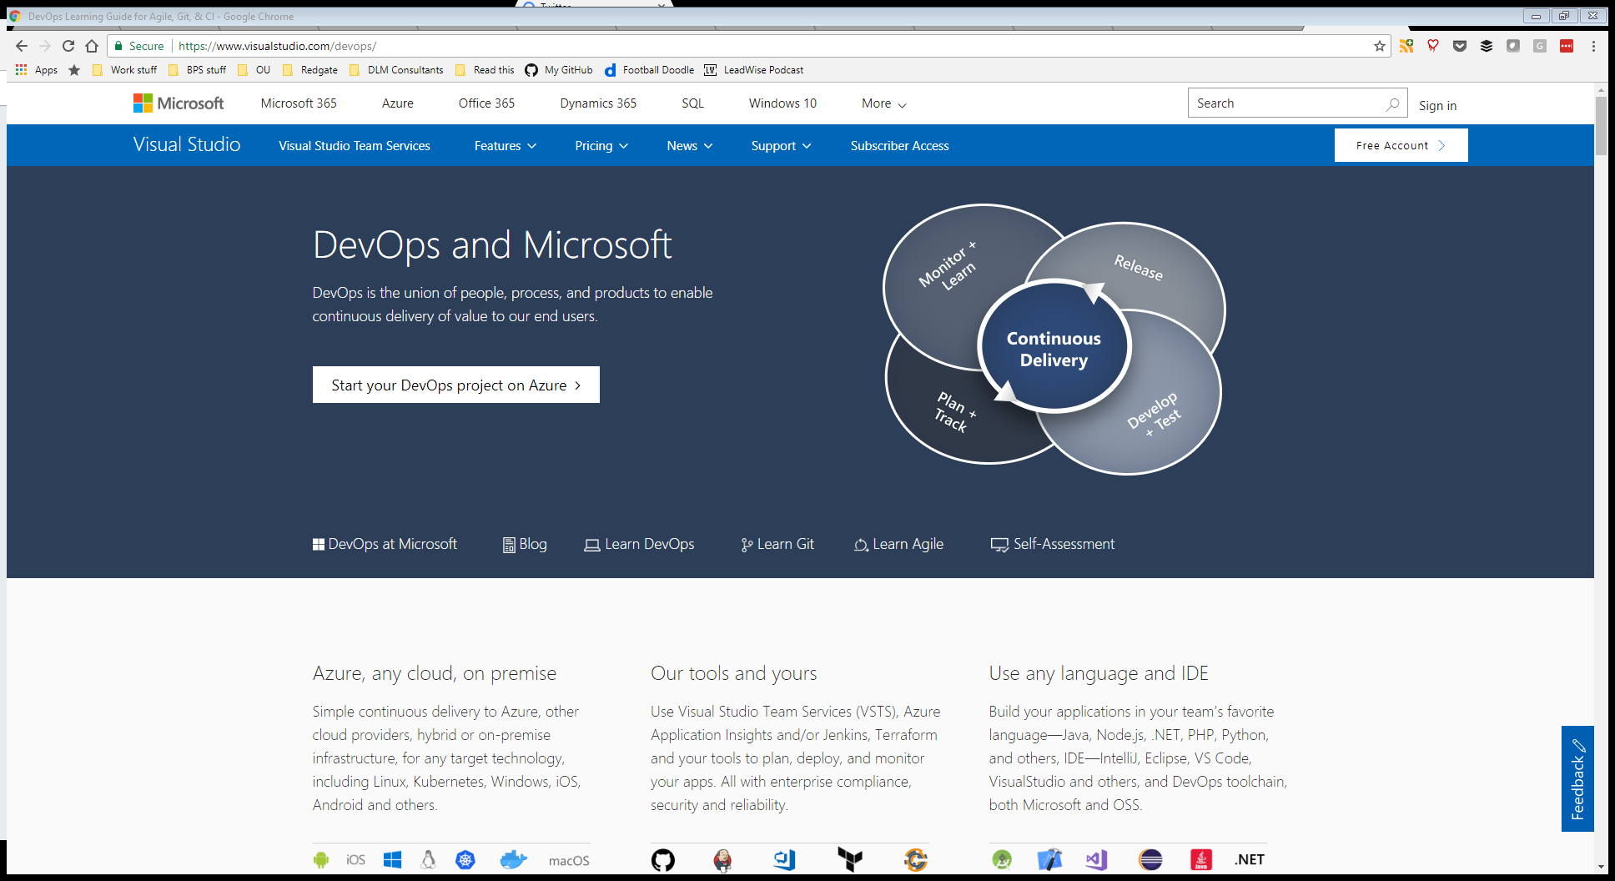
Summary
Notes:
As MS articulates it

Slide 31

“No matter what they tell you, it’s always a people problem”
Gerald Weinberg
Notes:
Remember, this is about people

Slide 32
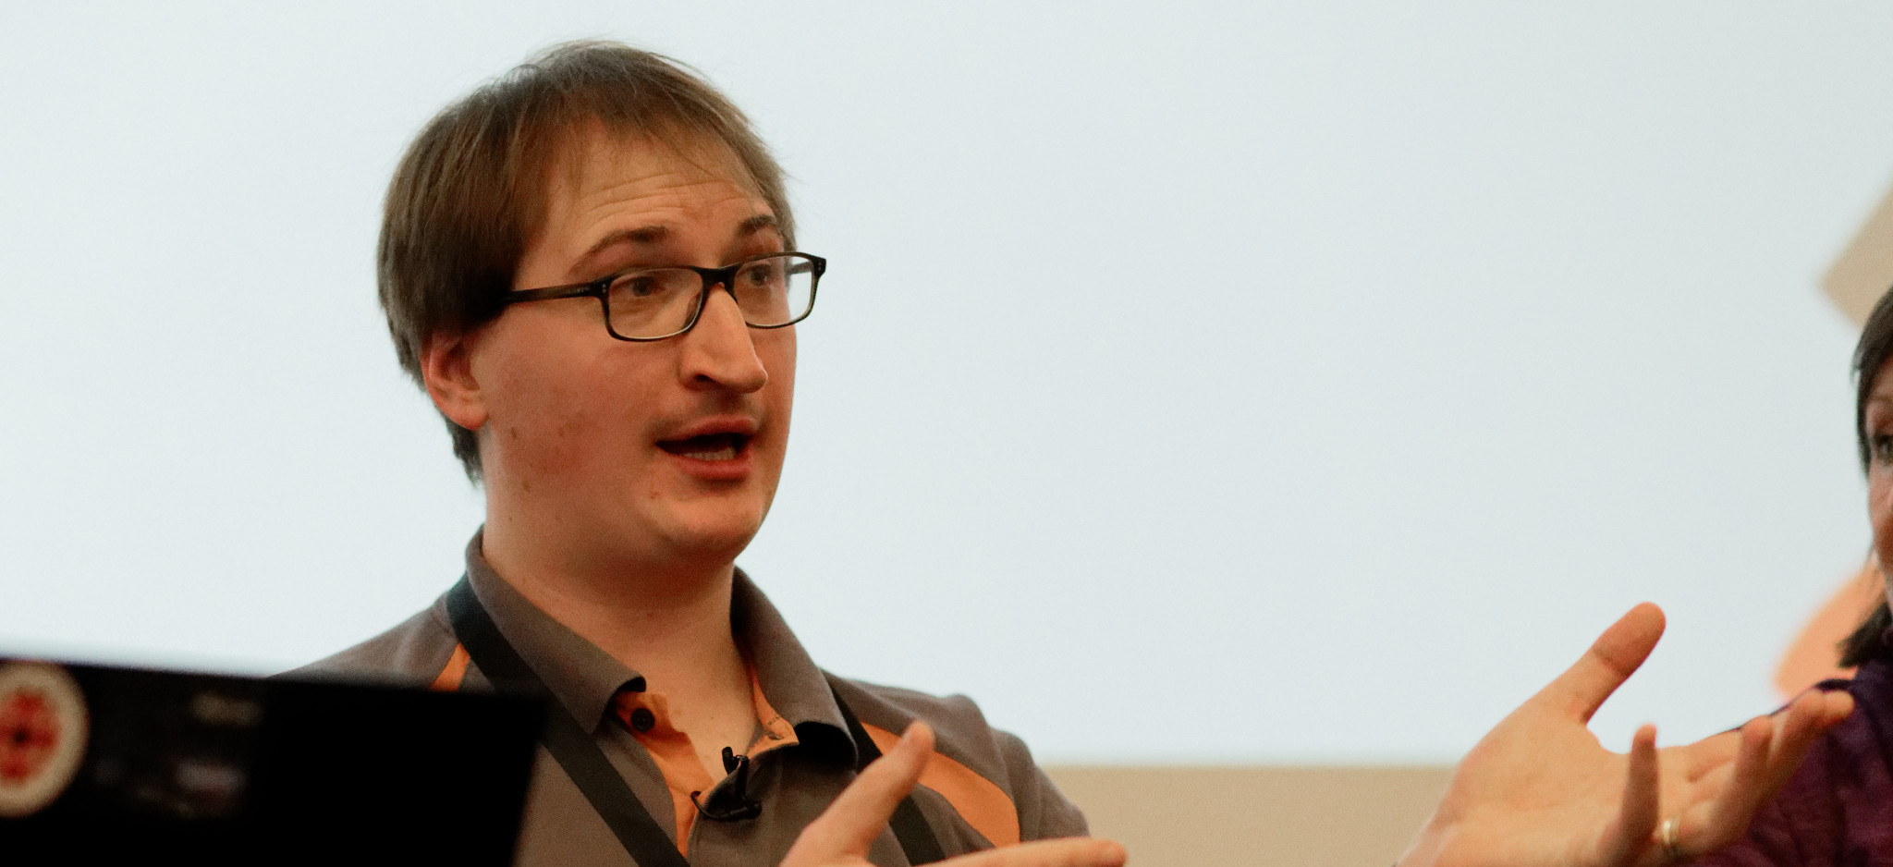
“DevOps provides a shared language that bridges many silos – not just ‘dev’ and ‘ops’. This language enables tech folks to collaborate intelligently with senior leadership and budget holders, as well as other business functions like sales and marketing. DevOps means optimising for the whole in the broadest sense.”
Alex Yates
Notes:
My attempt to summarise why DevOps is a fundamental concept for anyone in any business the relies on IT to understand. From DevOps, everything we do follows.

Slide 33
What does this mean for me?
Value: Relentless focus on users. Understanding the value of your work.
People: Always be learning. Small, autonomous teams with broad skills.
Process: Collaboration. Feedback. Visualise the VSM and constraints.
Products: Git. CI/CD tools. Infra as code. Test frameworks. Telemetry.
Metrics: Lead time, Deploy frequency, MTTR, Change fail %
Notes:
So, spell it out to me – as an attendee what should I take away from this talk.

Slide 34

“The key to successful change is measuring and understanding the right things with a focus on capabilities—not on maturity.”
Nicole Forsgren, Accelerate
Notes:
Awarding the final word to Nicole. An appropriate message for a data driven community.

